Slide 1
Basics of Program Evaluation & Reporting
Training Presented By: Pacific Resources for Education and Learning
Dr. Genevieve Manset and Sonja Evensen
For: Consolidated Grants Management Office
Pago Pago, American Samoa
January 14-16, 2019
DAY 1
January 14-16, 2019
DAY 1

Slide 2
Icebreaker
4 groups
Each group member shares 1 word that describes their feeling/experience with evaluation.
Each group agrees on a group name (Example: #loveit; #anxious) based on group results.
Groups share names.
Commonalties? Differences?

Slide 3
Introductions

Slide 4
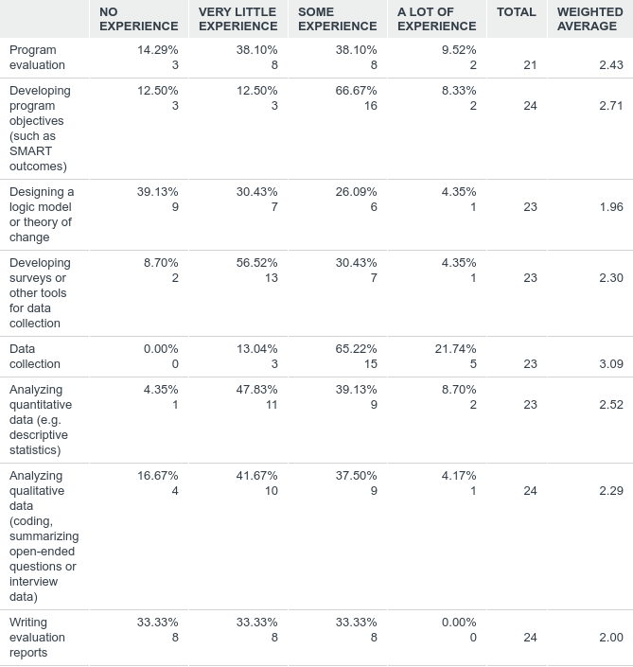
Pre-survey Q5: current experience in evaluation
Answered: 24 Skipped: 2

Slide 5
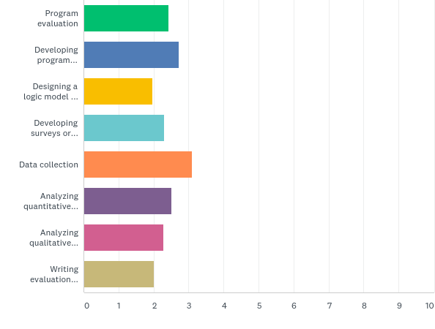
Prior experience in evaluation
Answered: 24 Skipped: 2

Slide 6
Overview of the 3 day session
Day 1.
Define program/ plan evaluation
Day 2.
Implement the evaluation/ interpret results: Questions and data
Day 3.
Communicating and using results

Slide 7
Goals for Today To increase our knowledge of program evaluation by:
01
Create SMART outcomes
Develop a Logic Model
Understanding a Theory of Action and Logic Model
02
03

Slide 8
What is Evaluation?
A systematic collection and analysis of data needed to make informed decisions about a specific program or intervention.

Slide 9
Telling your story

Slide 10
Purposes of an Evaluation
Justification: helps justify delivery of services
Documentation: demonstrate program outcomes were achieved
Accountability: show that funds are spent appropriately and efficiency
Decision-making: helps make informed decisions about program’s future direction

Slide 11
ASDOE and Grant Award Notification (GAN) requirements
List: What are the key requirements for reporting? What are the deadlines?
What data and data tools are you already using?
ASDOE must abide by the terms of each Grant Award Notification (GAN) which may require the grantee to conduct and submit an internal or external evaluation(s) of grant activities.
ASDOE is required to submit agency-wide quarterly performance reports to the ASG OPPBD on January 15, April 15, July 15, and October 15 of each year.
Data collected through required grant monitoring and evaluation processes may be included in these reports.

Slide 12
Developing an Evaluation Plan
Give me six hours to chop down a tree and I will spend the first four sharpening the axe.
- Abraham Lincoln

Slide 13
STEPS IN EVALUATION
STEP 1: DEFINE – What is the program?
STEP 2: PLAN – How do I plan the evaluation?
STEP 3: IMPLEMENT – How do I evaluate the program?
STEP 4: INTERPRET – How do I interpret the results?
STEP 5: COMMUNICATE (a) and REFINE (b) – How do I use the results?

Slide 14
STEP 1: DEFINE your Program
Problem Statement
Theory of Action
“SMART” Outcomes

Slide 15
Problem Statement
What is the Problem the program is designed to address?
Examples:
Too few of our students who graduate are going to college.
Students in our high schools are struggling in algebra.
There is a high absentee rate in our Kindergarten programs.
Many students with disabilities are not being identified early enough.

Slide 16
Theory of Action Defined
A theory of action is a statement that describes our approach to the work and how that work connects to our intended outcomes.
It answers the questions:
What are we trying to do?
How are we going to do it?
Adapted from: U.S. Department of Education (2016). Planning Together to Improve Outcomes for All Students. Office of Elementary & Secondary Education (OESE), Office of Special Education and Rehabilitative Services (OSERS), Implementation and Support Unit (ISU)

Slide 17
Theory of Action: Example Family Garden
Problem Statement: My family is not eating enough healthy foods; we never include vegetables with our meals at home.
IF [Your Program]
THEN
THEN
My family grows a vegetable garden in backyard
My Family will eat a healthier diet that includes more vegetables
My family will have access to fresh vegetables all year round

Slide 18
Theory of Action Practice: Project READ
Problem Statement: Many students at Lelei School are struggling in reading, with most students scoring Basic or Below Basic in ELA on State Assessment.
IF [Project READ]
THEN
THEN

Slide 19
You Practice: Create a Theory of Action for your Program in your Evaluation Plan
IF [Project READ]
THEN
THEN

Slide 20
Theory of Action: Practice “Project READ”
Problem Statement: Many students at Lelei School are struggling in reading, with most students scoring Basic or Below Basic in ELA on State Assessments.
IF
We implement project READ.
THEN
students will receive more high quality, evidence-based literacy programs
THEN
our students will improve their reading skills

Slide 21
Writing “SMART” Outcome Statements
The expected results from program activities; the effect that gets measured
Changes in :
ATTITUDES
KNOWLEDGE
SKILLS
BEHAVIOR
Why? Evaluation/research questions are designed around program outcomes

Slide 22
Outcomes statements should be… SMART
Specific
who, what, when, where, why, how
Measurable numeric or descriptive measure
Achievable
realistic, enough resources
Relevant
consistent with mission/vision of program
Action oriented
use action verbs
Timely
can be accomplished within realistic and identified deadlines

Slide 23
Example “SMART” Outcome Statements
ATTITUDES
KNOWLEDGE
SKILLS
BEHAVIOR
By April 2019, My family will name 3 different types of vegetables they like to eat.
By June 2019, my family will be able to identify 3 ways to prepare vegetables that grow in our garden.
By February 2019, my family will be able to plant and care for at least 3 different types of vegetables that grow well in our garden.
By August 2019, my family will include a vegetable in our dinner meals at least two times a week.
GOAL: My Family will eat a healthier diet that includes more vegetables.

Slide 24
Practice “SMART” Outcome Statements : Project READ
ATTITUDES
KNOWLEDGE
SKILLS
BEHAVIOR
By the end of YR 1, 60% of Lelei School students will report they enjoy reading.
This Photo by Unknown Author is licensed under CC BY-NC-ND
GOAL: Lelei School students’ reading skills will improve

Slide 25
Practice “SMART” Outcome Statements : Project READ
ATTITUDES
KNOWLEDGE
SKILLS
BEHAVIOR
By the end of YR 1, 60% of Lelei School students will report they enjoy reading.
By the end of YR 1, 60% of Lelei School families will report that they assist their child with their reading and writing homework at least 1 time per week.
The percent of Lelei School students meeting or exceeding Basic on State Assessment will increase by 10% a year, each year for 3 years.
By the end of YR 1, 2, & 3, Lelei School students will define a minimum of 50% of words on their grade level vocabulary word lists.
This Photo by Unknown Author is licensed under CC BY-NC-ND
GOAL: Lelei School students’ reading skills will improve.

Slide 26
Practice “SMART” Outcome Statements : Your Project Program Evaluation Template

Slide 27
Share Your Outcome Statements: Are they:
Specific
who, what, when, where, why, how
Measurable numeric or descriptive measure
Achievable
realistic, enough resources
Relevant
consistent with mission/vision of program
Action oriented
use action verbs
Timely
can be accomplished within realistic and identified deadlines

Slide 28
Lunch break!

Slide 29
What is a Logic Model?
It is a roadmap of your program
Clarifies the link between goals & activities
It is a required element for future grant applications

Slide 30
What is the difference?
Theory of Action, Theory of Change, Logic Model
Theories of Change (ToC) or Theory of Action (ToA)
Logic Model
explains HOW and WHY the desired change is expected.
is like a microscopic lens that zooms in on a specific pathway within the TOC.
gives the ‘big picture’
summarizes work at a strategic level
See: https://www.theoryofchange.org/wp-content/uploads/toco_library/pdf/TOCs_and_Logic_Models_forAEA.pdf

Slide 31
Core Components of a Logic Model Simple logic model chain
Strategy
Results
Inputs
»
Activities
»
Outputs
»
Outcomes
Resources: staff, stakeholders, curricula, spaces, approvals, funds
Tasks needed to accomplish program outcomes
Services, events, products designed to reach target population
Results of program activities; measurable, demonstrable change in the target population or program
A diagram of the theory of how a program is supposed to work
A picture of relationships between activities and results

Slide 32
Logic Model
Inputs | Activities | Outputs | Short term outcomes | Longer term impact
Resources: staff, stakeholders, curricula, spaces, approvals, funds | What you do in your program | # of events, products, etc. | Short term measurable, demonstrable results | Results of program activities; measurable, demonstrable change in the target population or program

Slide 33
Healthy New You Logic Model
Inputs | Activities | Outputs | Short term outcomes | Longer term impact
Menu/ calorie counter/ Nutrition guide Supplies: running shoes, scale, logbook etc. Other? | Exercise: Swimming, walking, aerobics | Step tracker # of laps # of classes | Weight loss Strength increases Cardio-vascular improvement (BP) | Decrease likelihood of heart attack/stroke, overall improved health
 | Dieting: eating a low carb, high glycemic (sugar free) diet | Logbook of daily intake | Weight loss More energy | Decrease likelihood of diabetes, Overall improved health
 | YOU TRY! | YOU TRY! | YOU TRY!

Slide 34
Program Read at Lelei School
Inputs | Activities | Outputs | Short term outcomes | Longer term impact
Staff X X X | Provide reading program…. | # of sessions… | Improve/increase KASB….
In teams, create a poster for Project Read Logic Model

Slide 35
Program Read at Lelei School
Inputs | Activities | Outputs | Short term outcomes | Longer term impact
Staff Funding Curriculum | 1) Provide Excellence Reading Curriculum in Grades K-6 | # of sessions | Improve students’ attitude about reading and writing Increase student engagement in reading and writing | Lelei School students’ reading skills (word reading, fluency, vocabulary, comprehension) will improve
 | 2) Provide Afterschool homework assistance program for Grades 4-6 | # of sessions
 | 3) Host Family Literacy Nights | # of events | c) Increase parent involvement in student learning

Slide 36
You Try!
Inputs | Activities | Outputs | Short term outcomes | Longer term impact
Resources: staff, stakeholders, curricula, spaces, approvals, funds | What you do in your program | # of events, products, etc. | Short term measurable, demonstrable results | Results of program activities; measurable, demonstrable change in the target population or program

Slide 37
Day 1 Exit Pass
Please complete an exit survey before you leave!

Slide 38
Questions?

Slide 39
Fa'afetai!!
See you tomorrow at 8:30am!

