Slide 1
Basics of Program Evaluation & Reporting: Day 3
Training Presented By: Pacific Resources for Education and Learning
Dr. Genevieve Manset and Sonja Evensen
For: Consolidated Grants Management Office
Pago Pago, American Samoa
January 14-16, 2019
DAY 3

Slide 2

Overview of
Day 3 session
Day 1.
Define program/ plan evaluation
Day 2.
Implement the evaluation/ interpret results: Questions and data
Day 3.
Communicating and using results

Slide 3
Goals for Today
To increase our knowledge of program evaluation by better understanding common ways of:
Using and communicating evaluation findings.
analyzing and interpreting evaluation results
using descriptive statistics, tabulation, and data visualization
01
02
03

Slide 4
using and communicating evaluation findings
01

Slide 5
How Do I Use the
Evaluation Results?
Informing for Program Improvement
Informing for Accountability
Refining the Program’s Theory

Slide 6

Reporting Evaluation Findings
Consider how you will report your findings to various audiences
May need several “versions” of report
  Funders
  Community members
  Newspapers/Media
  Legislature
  Future funders

Slide 7
Standard Reporting Format
 | Seven (7) Typical Components
1. | Introduction (purpose of evaluation; brief description of the evaluation; literature review if necessary)
2. | Methods (evaluation design; data collection and analysis methods, sampling)
3. | Results (present and interpret data)
4. | Conclusion (key findings, logical next steps, implication of findings)
5. | Recommendations (mid-course corrections, future programming, policy, etc.)
6. | References
7. | Appendix (data collection tools, other documents)

Slide 8

Ways to Communicate Your Findings
Comprehensive Report
A memo or letter;
A special newsletter or policy brief;
A conference call or individual phone call;
A presentation before a board or committee, or at a conference;
A publication in a journal, newspaper, or magazine;
A workshop;
A web page or blog; or
The school district newsletter or website.

Slide 9
Reporting tips
Use simple terms
Provide short bullet points: the essence
Graphics are helpful: also provide summary statements
What are the needs of the audience, what do they want to hear?
Present findings in context of the environment
Who is the best messenger to deliver the report?
Youth may be potential advocates—they may be able to talk about their experiences

Slide 10
Pair share:
• What do the people you work with, care about?
What communication formats do you often use when communicating your results?
• Thinking of a recent or upcoming assessment project, where would be one opportunity for you to use a new/different format for communicating your results?

Slide 11

Telling your story
Activity: in your workgroups, think of an audience you might want to reach and fill out the four quadrants

Slide 12
analyzing and interpreting evaluation results
02

Slide 13

I’ve collected all this data, now what?

Slide 14
STEPS IN EVALUATION
STEP 1: DEFINE – What is the program?
STEP 2: PLAN – How do I plan the evaluation?
STEP 3: IMPLEMENT – How do I evaluate the program?
STEP 4: INTERPRET – How do I interpret the results?
STEP 5: COMMUNICATE (a) and REFINE (b) – How do I use the results?

Slide 15
Data Analysis & Interpretation
Data analysis
act of identifying and explaining core meaning of the data.
Interpretation
is a process of inspecting, cleansing, transforming data in order interpret it
use a range of tools—including tabulation, data visualization, and statistical analysis
Summarizing and drawing conclusions

Slide 16

Important Tips for Data Analysis and Interpretation
Organize your analysis based on your Evaluation Questions.
Data Analysis and interpretation of findings should be ongoing. Do not wait until the end of the evaluation!

Slide 17
Common Ways to Summarize Quantitative Data for Evaluation
Descriptive Statistics: Counts, Averages, (Mean, Median) Percentage
Tabulation: Create tables
Data Visualization: charts, graphs, plots, and/or information graphics
Complex Data Sets and More In-depth Analysis: more sophisticated statistical techniques, such as regression analysis, analysis of variance, multilevel modeling, factor analysis, and structural equation modeling can be used.

Slide 18
Analyzing and Summarizing Qualitative Data (open-ended survey questions, interviews, case studies, or observations)
Use a Rubric to summarize observations, interviews
Summarize data by Themes: identify a, organizing data evaluation question themes, coding data by theme, and interpret themes.
Qualitative Table Summaries
Selected Quotes to support qualitative evidence

Slide 19
Analyzing and Summarizing Qualitative Data (example Tabulation )

Slide 20
Concluding
Give the rationale for how conclusions were reached
Describe what the audience should do with the information they receive--action they or others should take
Focus on implications: (the So What?)

Slide 21
Drawing conclusions: Is there is a “true” difference between groups, pre/post?
  Statistical Significance: a statistically significant result (usually a difference) is a result that’s not attributed to chance (p<.05)
  Percentage Differences: (rough estimates/ rules of thumb)* :
    for small groups of students (50 or less total) at least a 13% point difference between groups
    For moderate size groups of students (200 or more total) at least a 6% difference between groups.
    For large groups of students (over 500 total) at least a 4% difference between groups to be considered different
*Love, N. et al (2008) The Data Coaches Guide to Improving Learning for all Students Corwin Press, Thousand Oaks, CA p 152

Slide 22
Drawing conclusions: Has there been enough growth?
Benchmarks- A benchmark acts as the minimum level of performance
For example: (Project is successful if…)
Participating students attend school at least 95% of school days.

Slide 23
using descriptive statistics, tabulation, and data visualization
03

Slide 24
Descriptive Statistics
  Count: total number
  Averages:
  Mean: the average of the numbers
  Median: the middle number in a series of numbers
  Percentage: any proportion or share in relation to a whole, rate out of a 100

Slide 25
Tabulation :
Summary Tables
 | Average Daily Attendance
 | Elementary |  |  | Secondary
 | Male | Female | Total | Male | Female | Total
Hibiscus School | 92% | 96% | 93% | 89% | 93% | 92%
Nation | 96% | 96% | 96% | 95% | 96% | 96%

Slide 26
Data Visualization
data or knowledge intended to present information quickly and clearly.[enhance ability to see patterns and trends.
data visualization uses statistical graphics, plots, information graphics

Slide 27
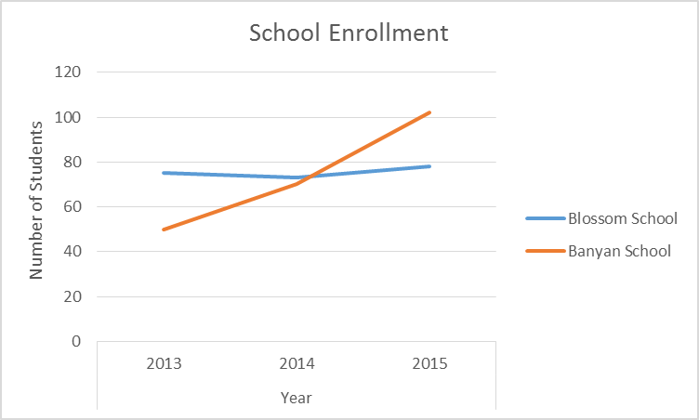
Why Graphs and Charts?
1) How do the two schools compare in enrollment?
2) What is the advantage of the graph over the table?
 | Enrollment
 | 2013 | 2014 | 2015
Blossom School | 75 | 73 | 78
Banyan School | 50 | 70 | 102

Slide 28
Activity
DIRECTIONS: For each chart of graph or your Worksheet Decide:
1. WHAT DO YOU SEE?
  represented on the horizontal axis ?
  represented on the vertical axis?
  What do slices of the pie represent? (Pie chart)
  What type of scores?
2. WHAT IS IT TELLING YOU?
  About differences between groups?
  About changes or trends over time?
Worksheet 3.1 : What’s the Difference? Examining charts and graphs for patterns and trends

Slide 29
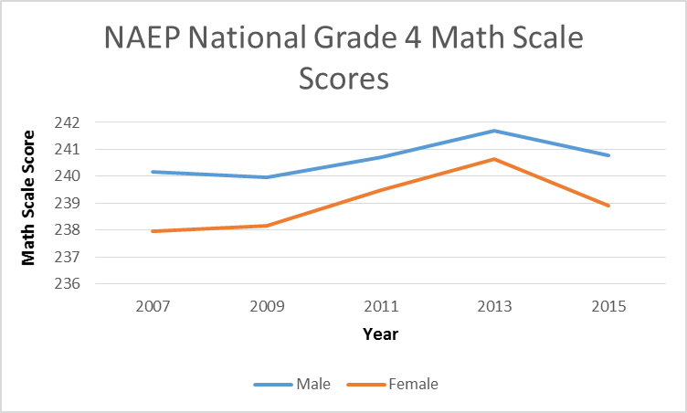
Practice Worksheet : What’s the Difference?

Slide 30
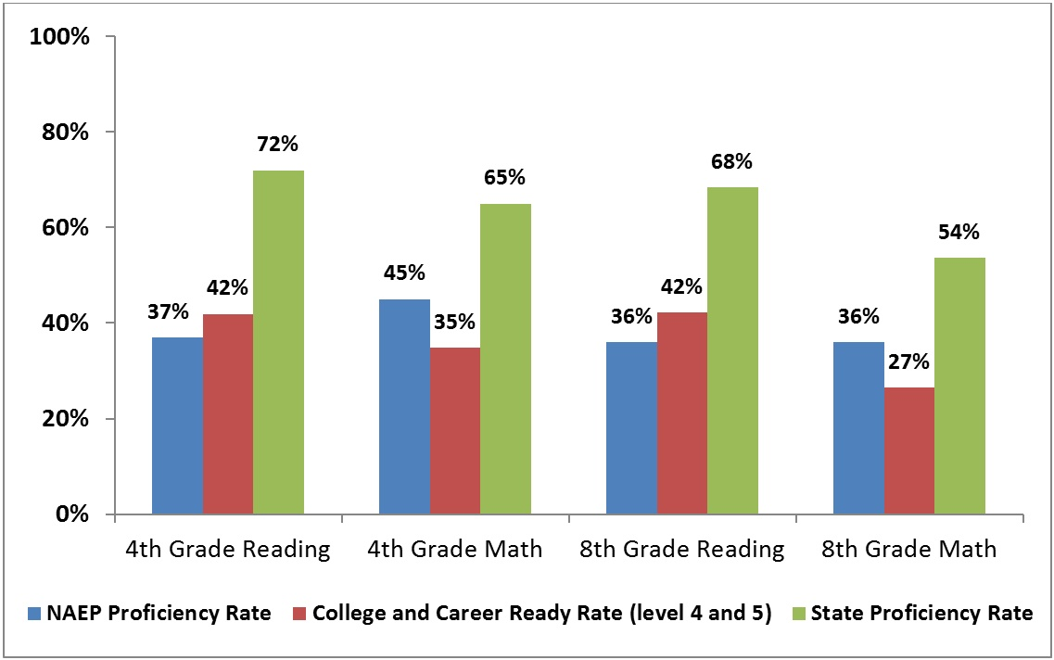
Practice Worksheet : What’s the Difference?

Slide 31
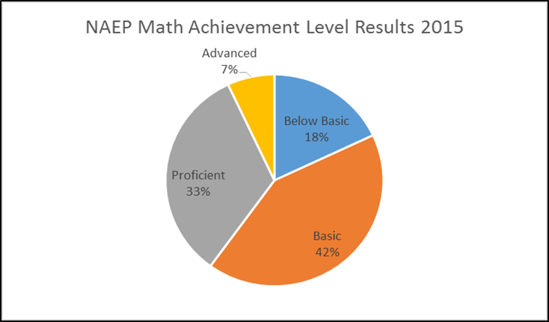
Practice: What’s the Difference?

Slide 32
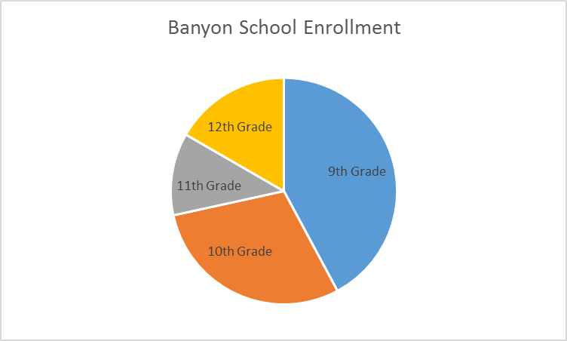
What type of Graph should I use?
Pie charts are best to use when you are trying to compare parts of a whole. They do not show changes over time. (% or Counts)
Bar graphs are used to compare things between different groups or to track changes over time.
Line Graphs measure measure change over time and difference between group; good for observing trends.

Slide 33

Activity 3. Apply to Your Grant Project
Pick one SMART outcome statements from each of your projects.
On the Poster Paper, create a table, graph, or chart for the Outcome you hope to achieve for each of them. Be sure to label well, and show change Pre-post or difference between groups.

Slide 34

GALLERY WALK
1. Group
  Start with your Group at your poster station.
2. Rotate and Begin
  Read the graphs. With post-its, note one thing you particularly liked about the poster, and any questions you may have.
3. Rotate –after 3 Minutes
  read and discuss the previous group’s response and add content of their own.
4. Repeat
5. Reflect
  on the Responses to Your Graphs

Slide 35

Lunch Break!

Slide 36

Finalize Your Evaluation Plans

Slide 37

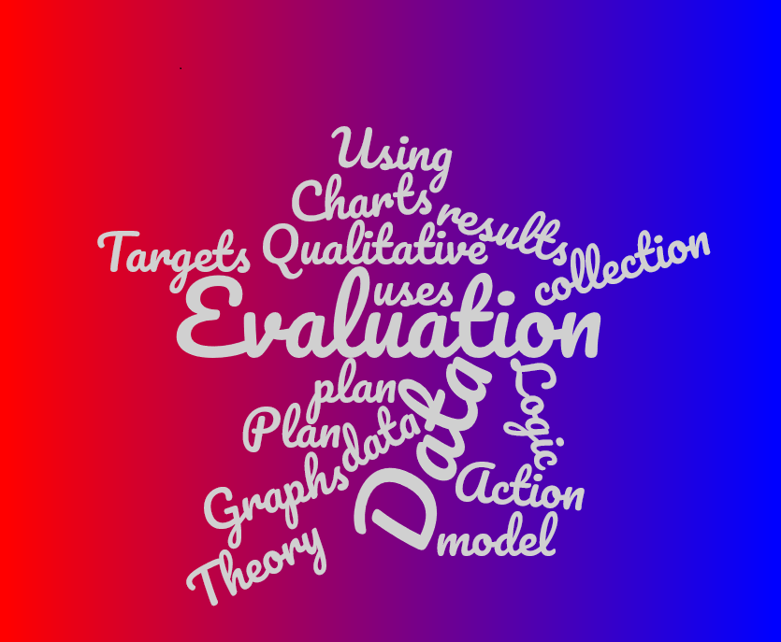
Wrap Up: final Q&A

Slide 38


Workshop Evaluation
Please complete the PREL workshop evaluation survey before you leave!

